Slide 1
Buffer Overflow Attack

Slide 2
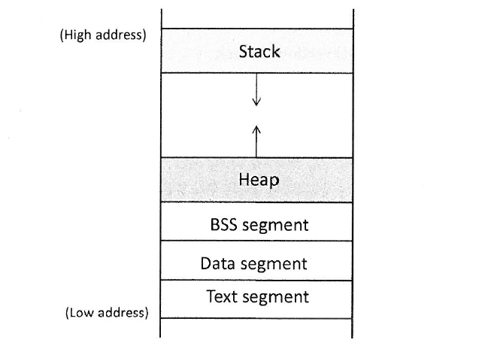
Program Memory Layout
Text segment : stores executable program
executable
Read - only
Data segment: static/global variables initialized by programmer
BSS (block started by symbol) segment:
Stores uninitialized global/static variables
Heap : Provides space for dynamic memory allocation
Stack

Slide 3
Program Memory Layout
Stack
Stores data for function calls
Stores local variables
By default non-executable

Slide 4
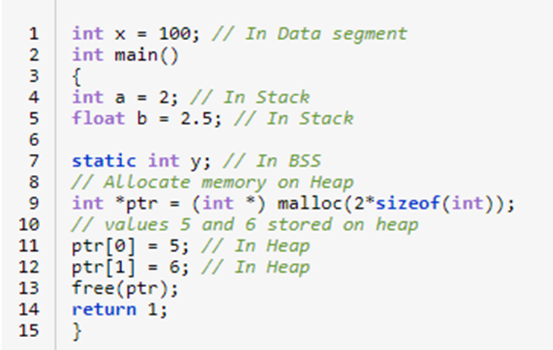
Program Memory Layout

Slide 5
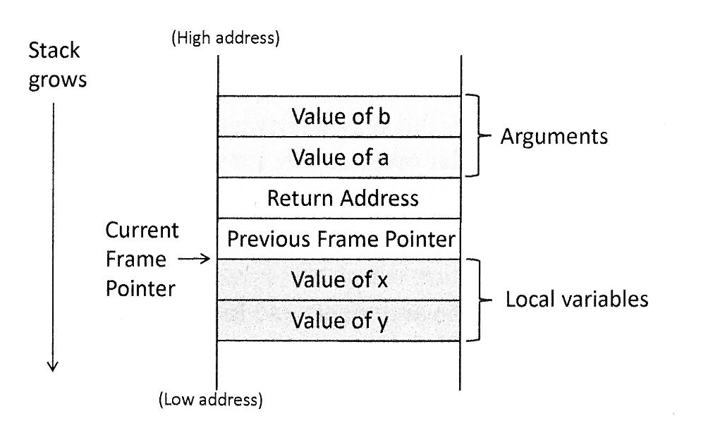
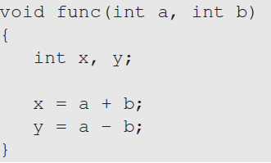
Stack and Function Invocation

Slide 6
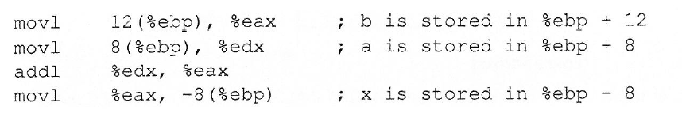
Stack and Function Invocation

Slide 7
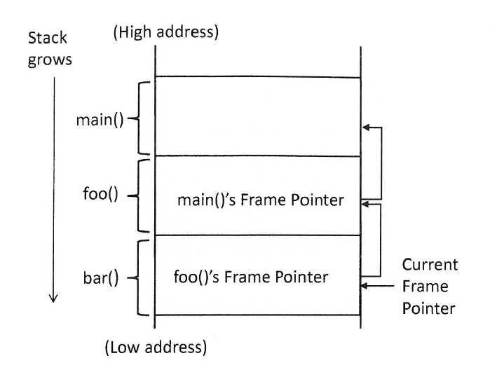
Stack and Function Invocation

Slide 8
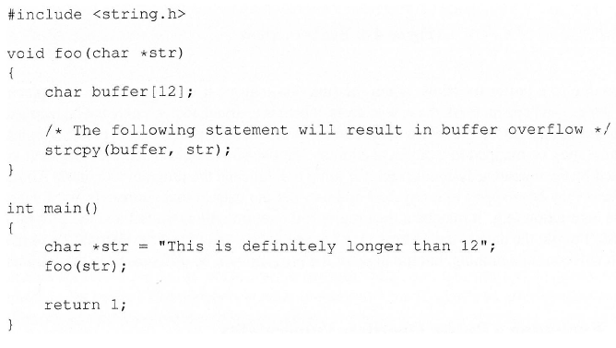
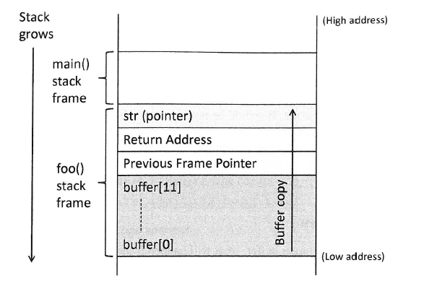
Buffer Overflow

Slide 9
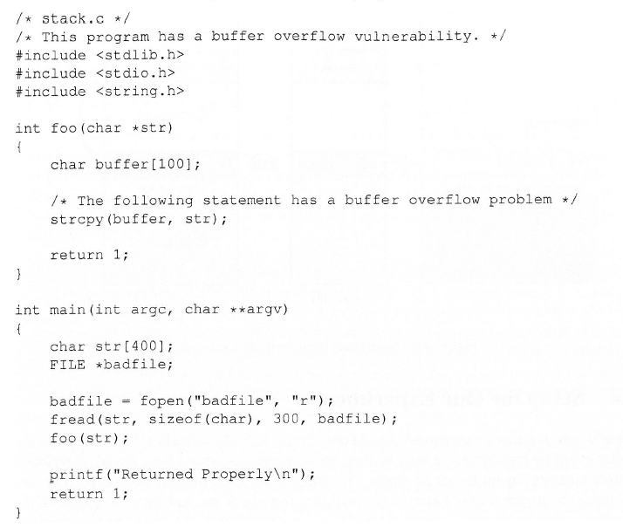
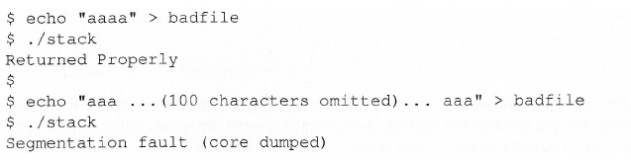
Buffer Overflow

Slide 10
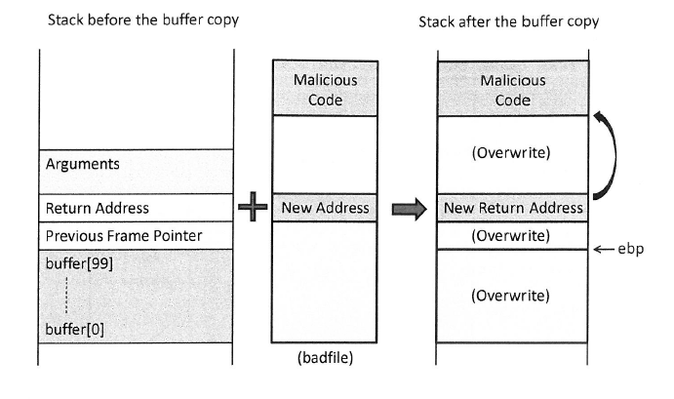
Buffer Overflow

Slide 11
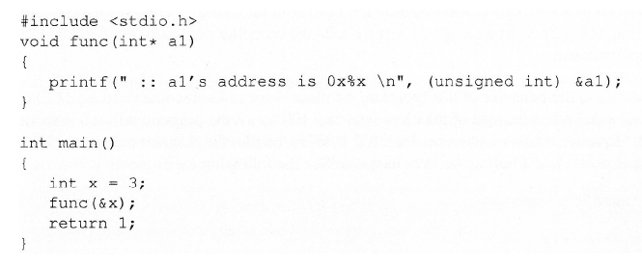
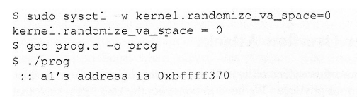

Buffer Overflow

Slide 12
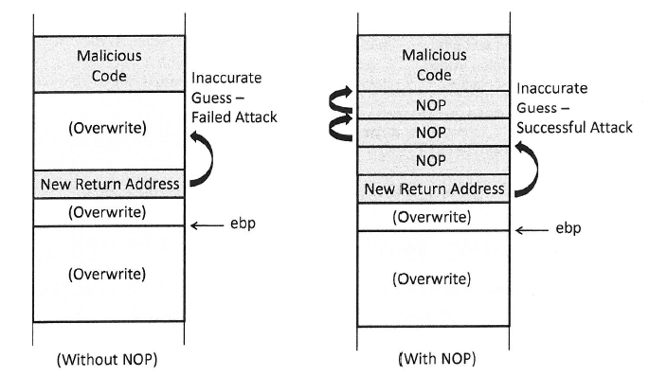
Buffer Overflow

Slide 13


Setup For Our Experiment

Slide 14
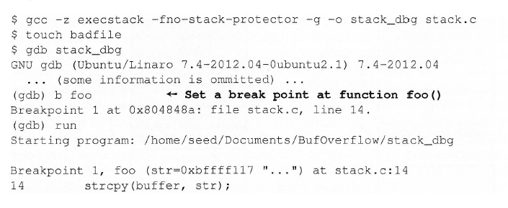
Conducting Buffer Overflow

Slide 15
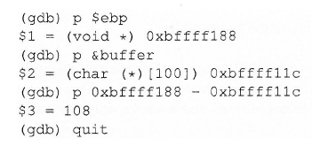
Conducting Buffer Overflow

Slide 16
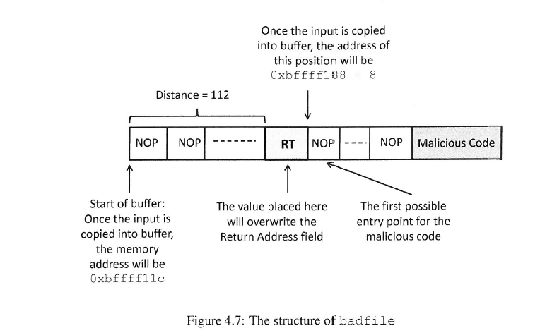
Conducting Buffer Overflow

Slide 17
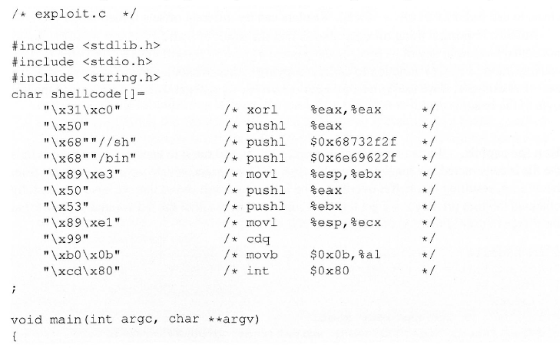
Conducting Buffer Overflow

Slide 18
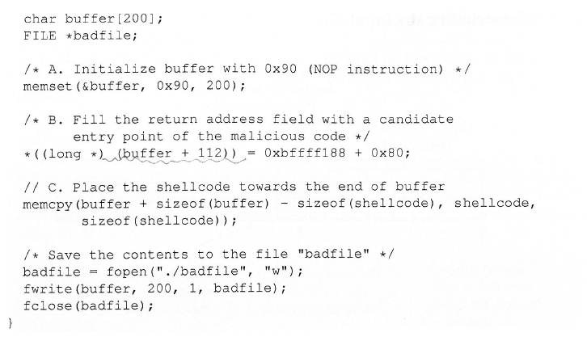
Conducting Buffer Overflow

Slide 19
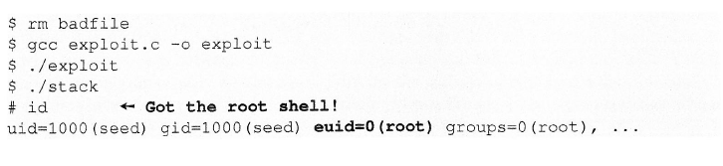
Conducting Buffer Overflow

Slide 20
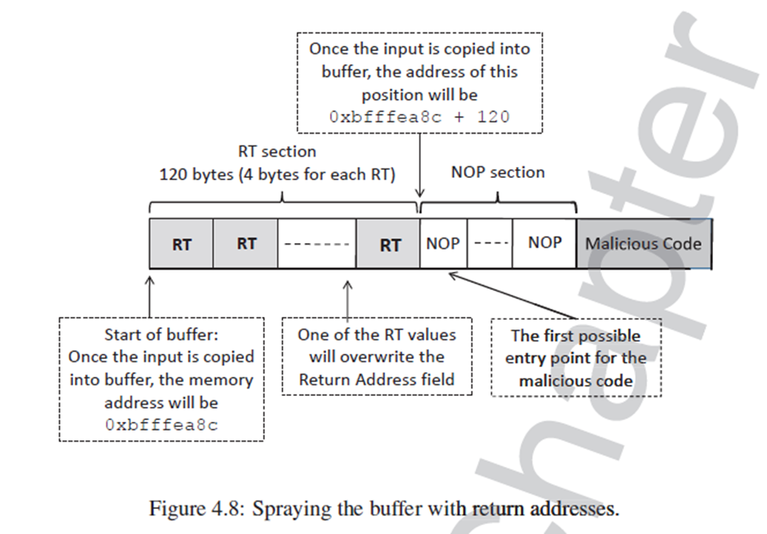
Attack With Unknown Buffer Size

Slide 21
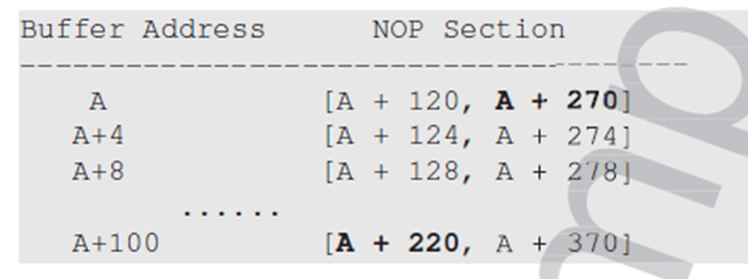
Attack With Unknown Buffer Address and Size

Slide 22
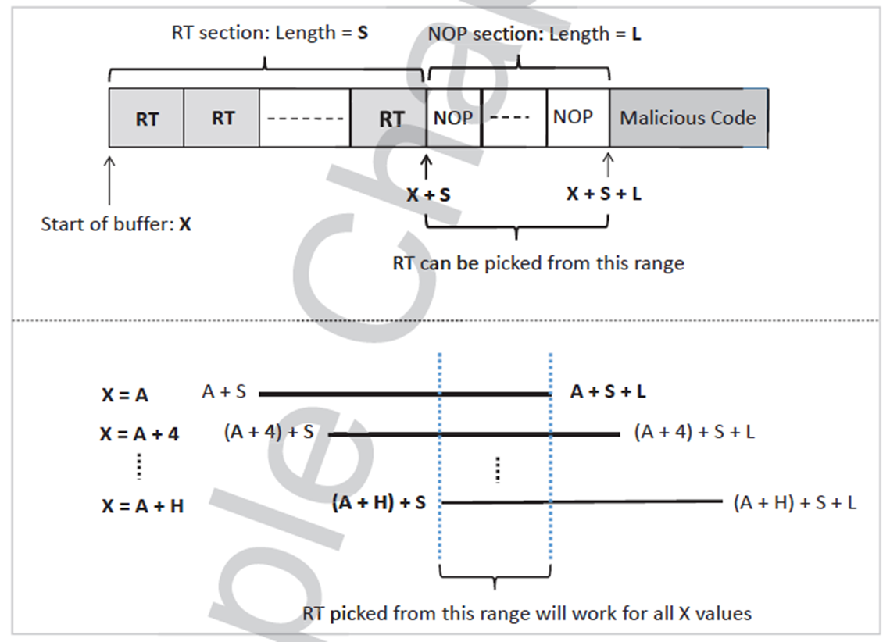
Attack With Unknown Buffer Address and Size

